Slide 1


Stock Price Prediction
Akhila Pulipati
Regis University

Slide 2

Introduction
What is Stock?
Stock is defined as a financial instrument that represents ownership in a company. Stock markets are where an individual and investors come together to buy and sell shares in public venue.
What is Stock Trading?
The process of buying and selling existing and previously issued stocks is called stock trading.

Slide 3
Problem Statement
Vectorized backtesting
Algorithmic Trading Strategy

Slide 4
About Dataset
The Stock price data of SPY, Amazon and Google companies is collected from yahoo finance site.
The data is collected between '06/19/2018' and '07/18/2021’
Dataset contains 3 columns and 775 rows.

Slide 5
Data Analysis Process flow
Simple Moving Averages
Deviation of positions
Vectorized Backtesting
Optimization
Random Walk Hypothesis
Linear OLS Regression

Slide 6
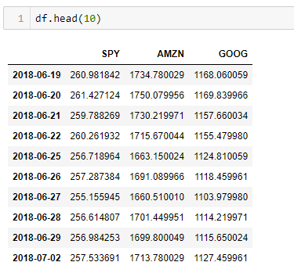
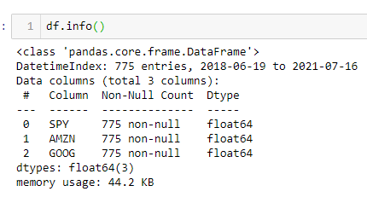
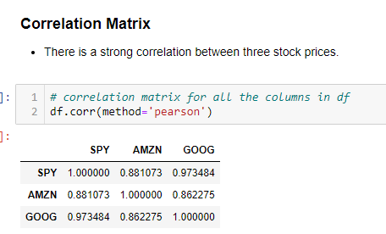
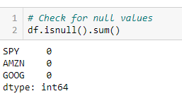
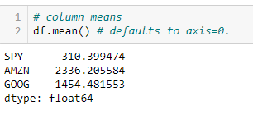
EDA

Slide 7
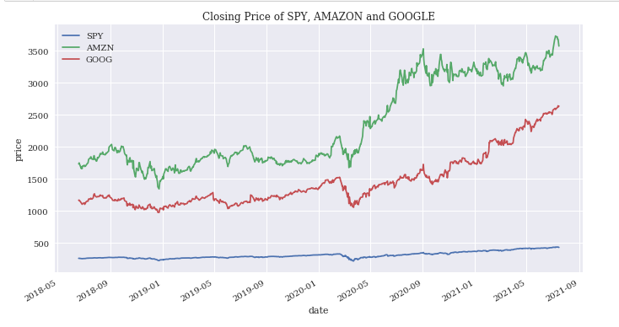
Data Visualization

Slide 8
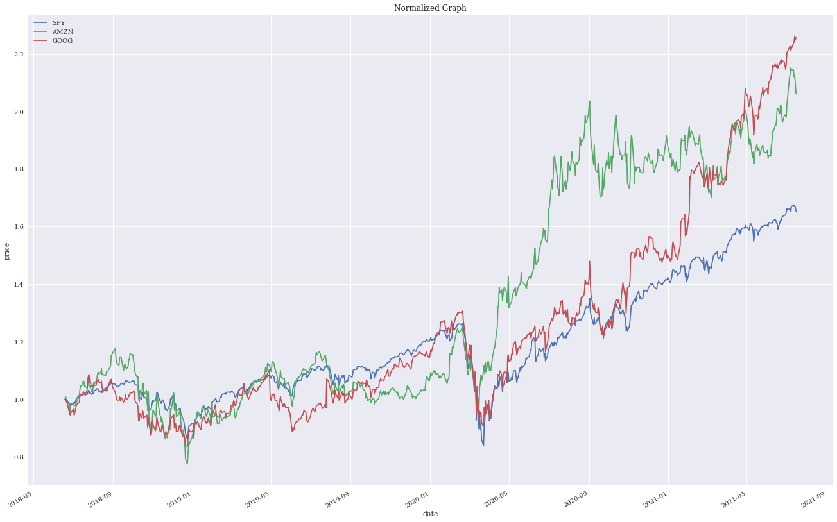
Normalized Graph of Stock price

Slide 9
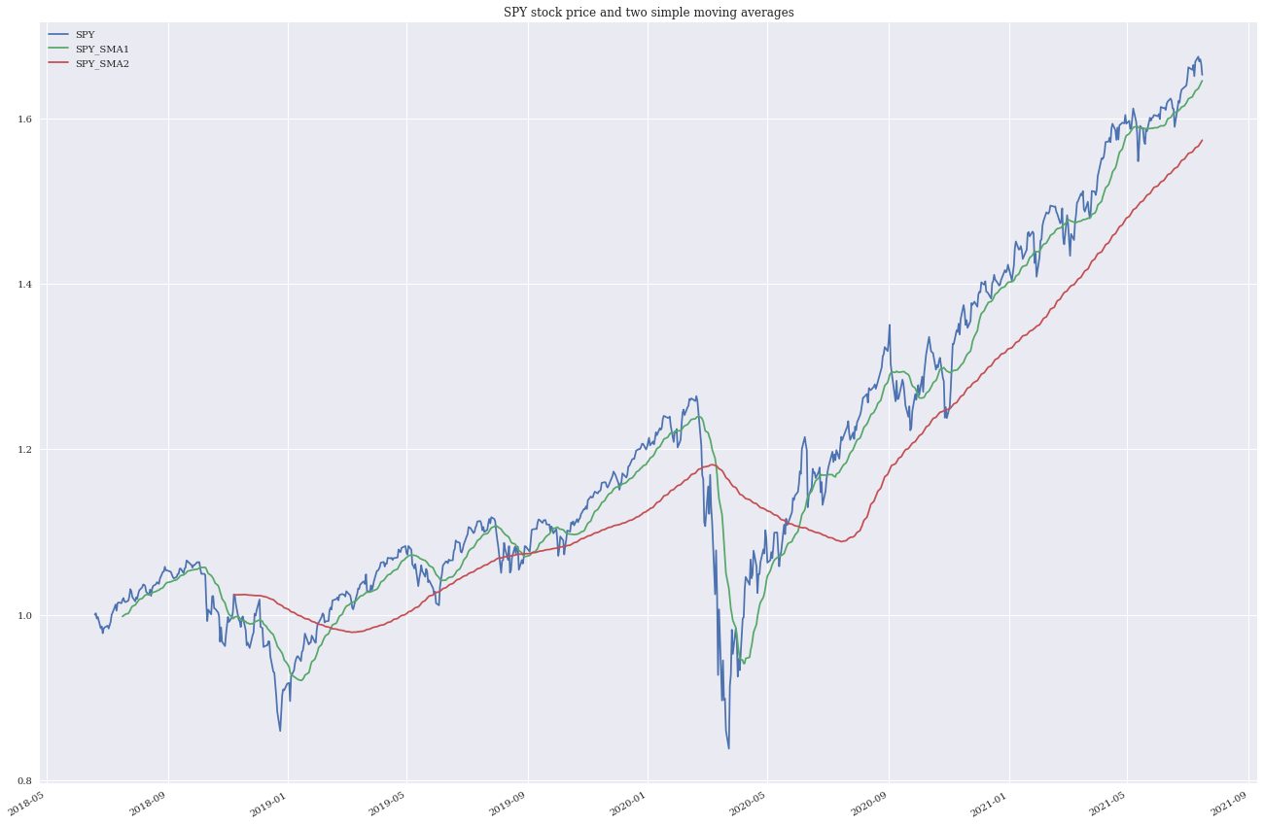
Simple Moving Average SPY stock price and two simple moving averages

Slide 10
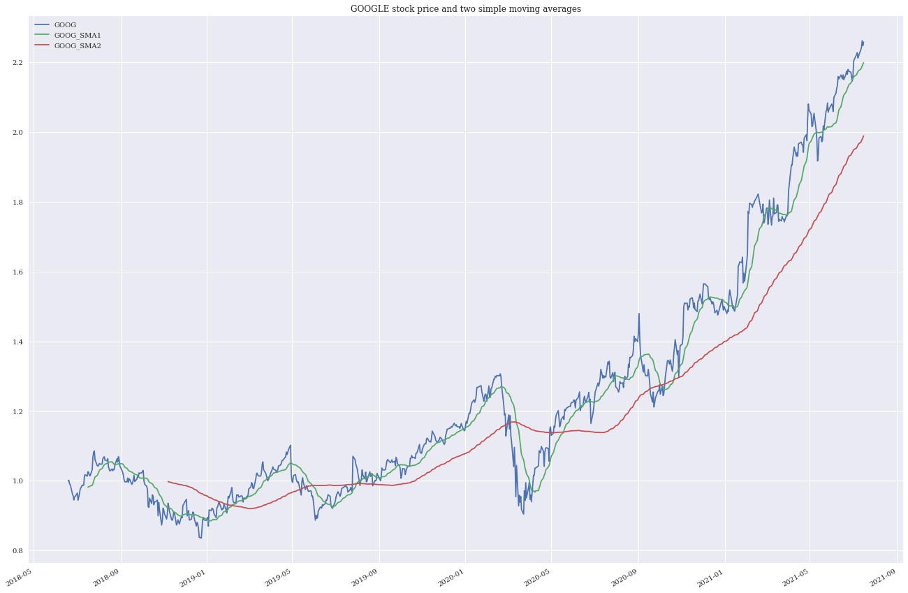
Google stock and two simple moving averages

Slide 11
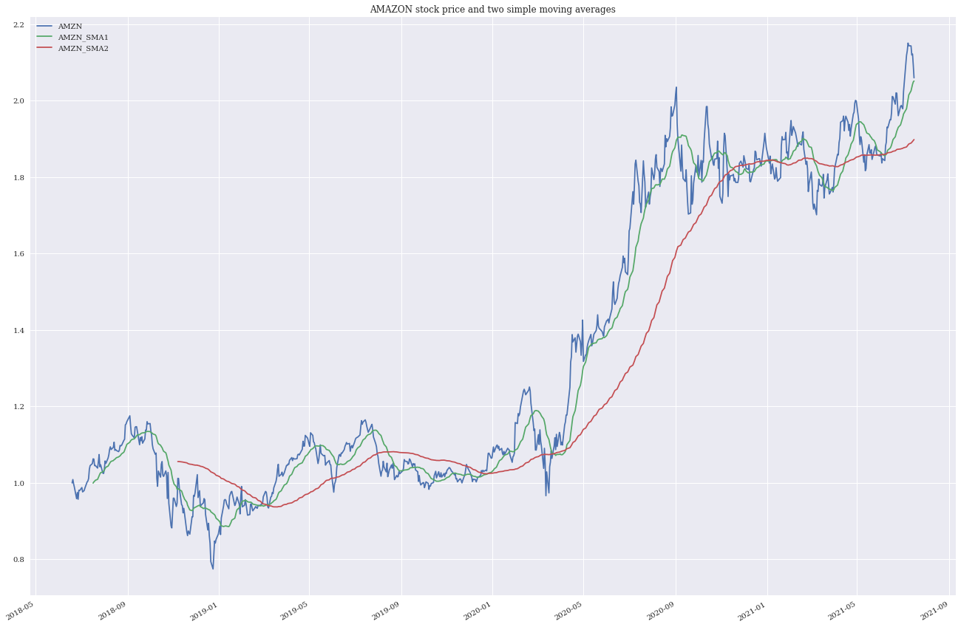
Amazon Stock and two simple moving averages

Slide 12

Deviation Positions
The trading rules are:
1. Go long (= +1) when the shorter SMA is above the longer SMA.
2. Go short (= -1) when the shorter SMA is below the longer SMA

Slide 13
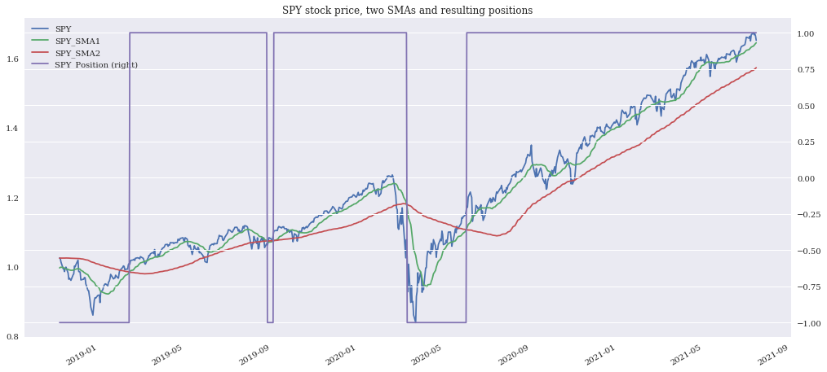
SPY Stock price, two SMAs and resulting positions

Slide 14
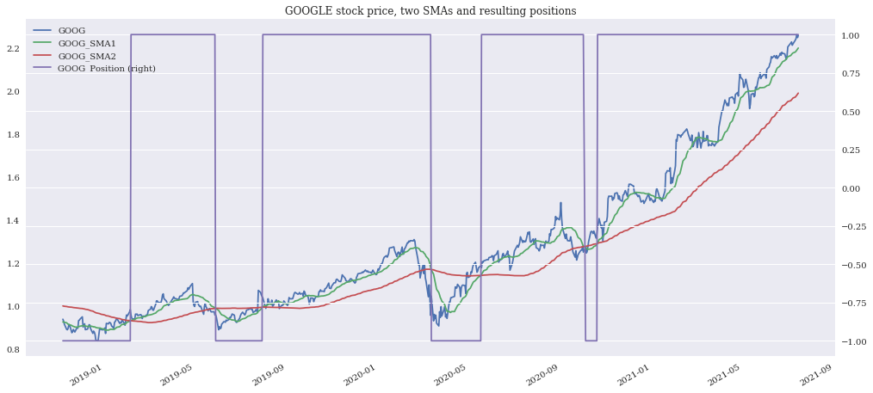
GOOGLE stock price, two SMAs and resulting positions

Slide 15
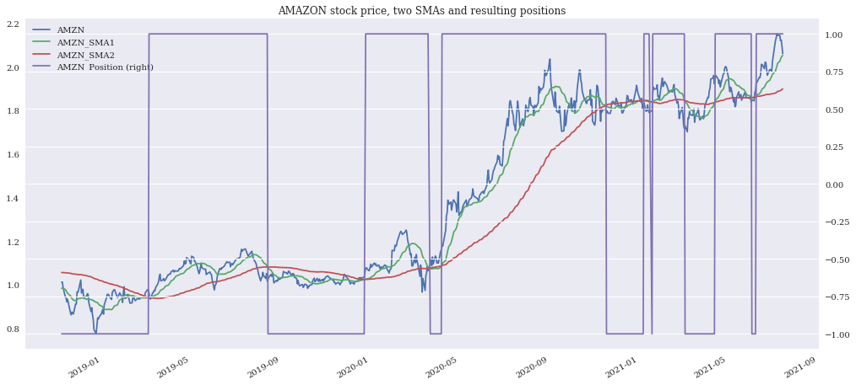
AMAZON stock price, two SMAs and resulting positions

Slide 16
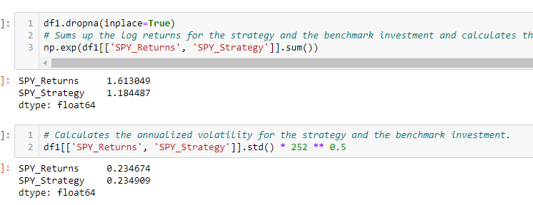
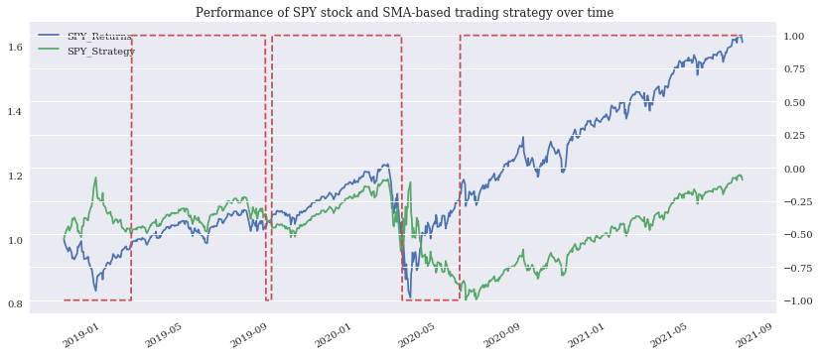
Vectorized Backtesting Performance of SPY stock and SMA-based trading strategy over time

Slide 17
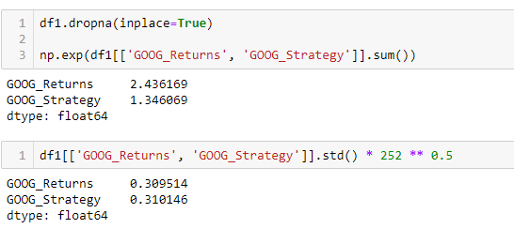
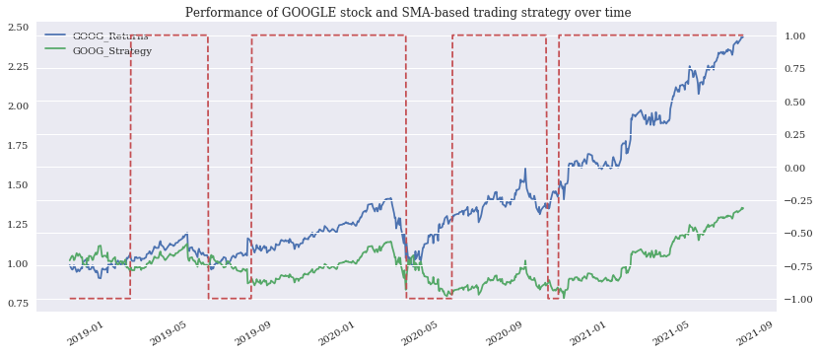
Performance of Google stock and SMA-based trading strategy over time

Slide 18
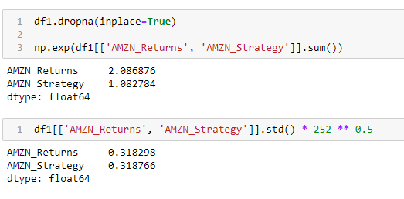
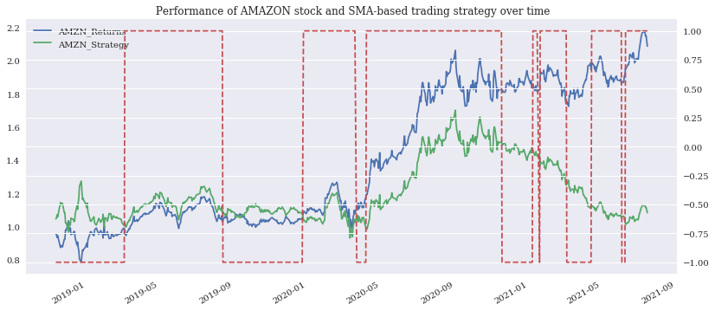
Performance of AMAZON stock and SMA-based trading strategy over time

Slide 19
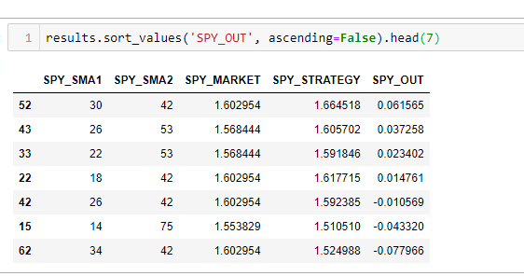
Optimization Optimization of SPY stock: - We have considered the parameter values as sma1 = range(10,61,4) and sma2 = range(20,130,11)

Slide 20
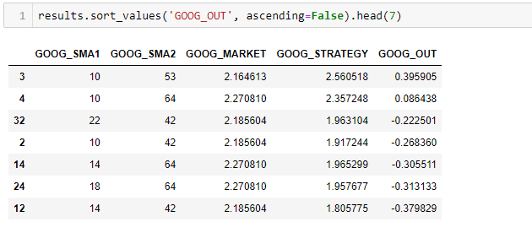
Optimization of Google stock

Slide 21
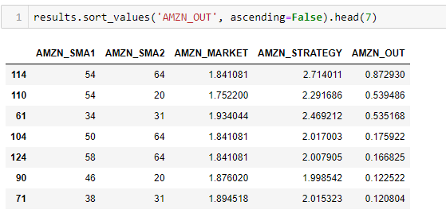
Optimization of Amazon Stock

Slide 22
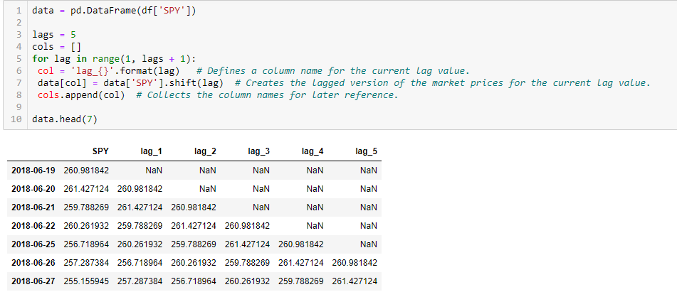
Random Walk Hypothesis The random walk hypothesis (RWH) approach says that the predictive approaches should not lead to any outperformance at all.
Create five lagged versions of the historical end-of-day closing levels of the SPY stock index

Slide 23
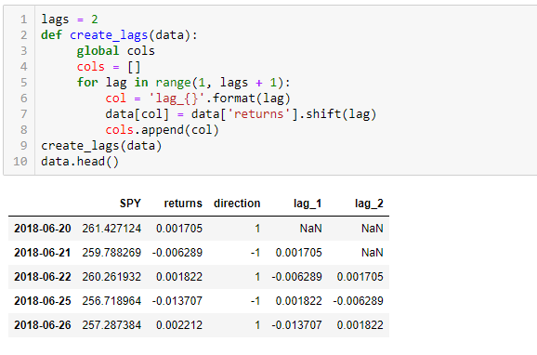
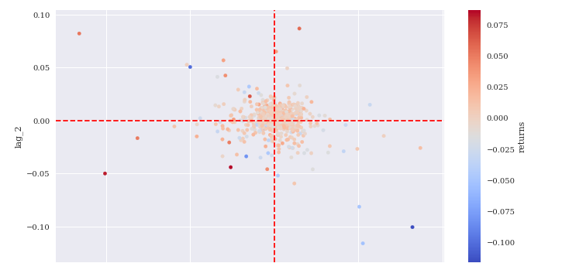
Linear OLS Regression
we apply linear regression for predicting the direction of market movements based on historical log returns.
Create and visualize the features data by lagging the log returns and returns

Slide 24
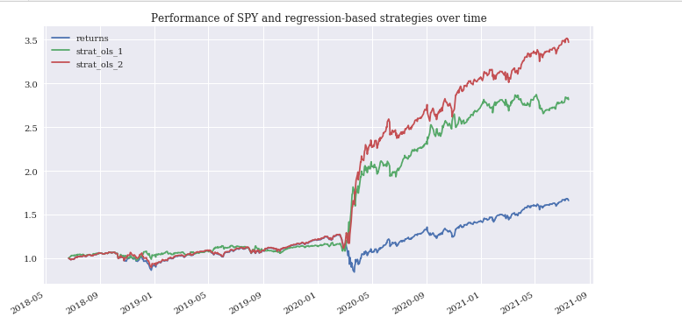

Slide 25
Thank You! ☺

